Slide 1
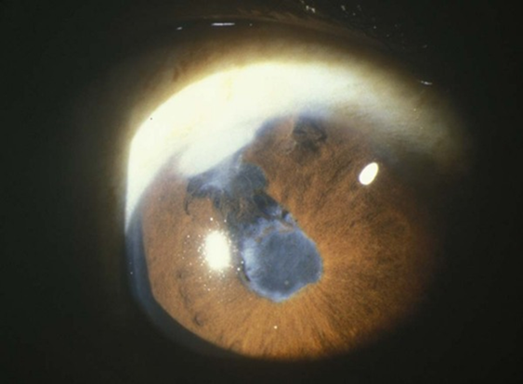
Cataract Surgery with
Chronic Uveitis Prepare by Hang Vra, md

Slide 2
Cataract Surgery with Chronic Uveitis
I-Introduction
II-Preoperative Condition for Surgery:
II.1. Inflammation
II.2. Ophthalmic Evaluation
II. 3. Management of Associated Glaucoma
II.4. Preoperative Planning
II.5. Visual Prognosis
III. Surgical Planning
III.1. Patient Preparation
III.1.1. Algorithm Decision
for Cataract in Uveitis
III.2. Surgical Procedure
III.3. Choice of IOLs
III.4. Intraoperative Managements
III.4.1. Intra/O Techniques
III.4.2. Intra/O Treatments
IV. Control Postoperative Inflams
V. Complications
VI. Postoperative Follow-up

Slide 3
I-Introduction
Cataracts is common complication of long time chronic uveitis, occurring as a complication of both disease process and the corticosteroids used Rx its.
Unusually of cataract formation:
    PS, iris atrophy, iris neovascularization, or secondary glaucoma, are severe degree of inflammatory damage to the anterior segment
    PS may be etiologically of localized lens opacities (this may be on the basis of microperforation of the lens capsule)
    Presence of toxic debris, oxygen free radicals from inflammation and local ischemia induced by S may damage lens fibers and epithelial cells, leading to lens opacities
    Mechanism of PSCC induced by corticosteroid use is not well known, but can be suggested by related to abnormal cellular metabolism induced by electrolytic imbalance.

Slide 4
II. Preoperative Condition for Surgical
II. 1. Inflammation
II. 2. Ophthalmic Evaluation
II.3. Management of Associated Glaucoma
II.4. Preoperative Planning
II.5. Visual Prognosis

Slide 5
II.1. INFLAMMATION
Very importance control intraocular inflame before, during and after surgery.
Ideal control of inflame is no cells and flar in AC, no active retinal inflammation and no macular edema.
Use topical or periocular steroids to reduce intraocular inflame for several weeks before surgery.
Topical (NSAIDs) may be beneficial to reduce the risk of postoperative CME

Slide 6
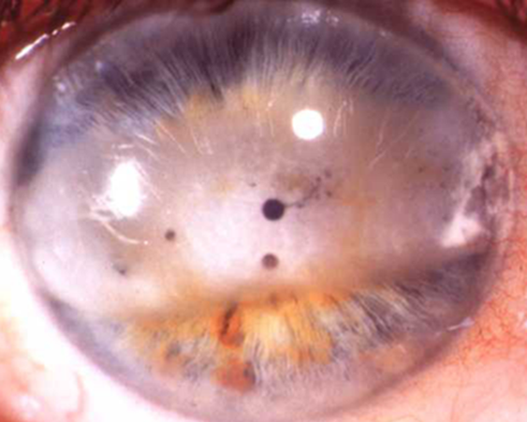
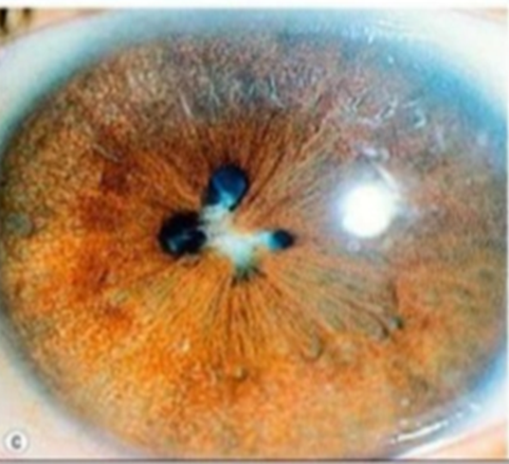
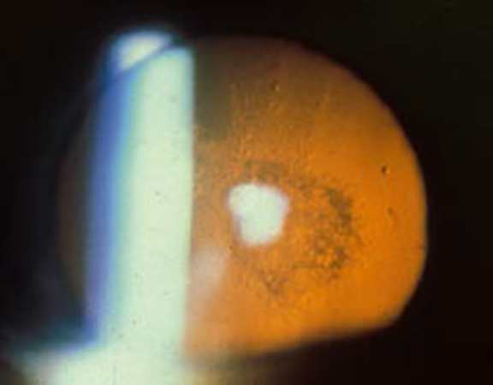
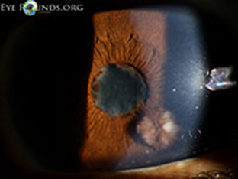
Difficulties start from the preoperative control of inflammation to intraoperative problems like poor visibility due to:
      Band keratopathy
      Small pupils
      Posterior synechia
      Pupillary membranes
      Abnormal iris vessels
      Anterior capsules
      With secondary glaucoma,

Slide 7
Inflammation Continue…
IOI, may associated with ↑, normal, or ↓ IOP, that
depending on severity of the inflammation, deposits in the trabecular meshwork, and the damage to the ciliary body:
    Proper control of the IOP is recommended 2–3 weeks prior to surgery.
    For low IOP, the appearance of a fibrinoid reaction during or immediately after surgery may be treated by ICI of 500–700 units of streptokinase or 10–25 μg of recombinant tissue plasminogen activator.

Slide 8
II.2. Ophthalmic examination
Complete ophthalmic examination, help us decide the
visual potential and visual loss that attributed by cataract, and
visual outcome of the surgery:
    S/L Evaluation, such as A/ or PS, presence of fibtinous membrane, hypotony, and shallowing or flare in AC and KPs.
    Complete systemic examination and laboratory evaluation (associated pathologies in patients with history of uveitis)
    Optical coherence tomography (OCT), for macular edema , also detect macular atrophy, epiretinal membranes and vitreomacular traction)
    B-scan, posterior segment for vitreous opacities, retinal detachment and choroidal thickening/detachment.

Slide 9
II.3. Management of Associated Glaucoma(G) . . . .
G associated with uveitis is the most serious complications of IOI, and patients respond poorly to surgery.
Primary importance to assess the severity of the inflammation and the etiology of the uveitis, need Mx includes Rx of the underlying inflammation and of the glaucoma itself.
Special considerations of corticosteroids are the cause of the high IOP.
Drug therapy is the first step in the treatment of uveitic glaucoma prior surgery.

Slide 10
II.4.Preoperative Planning (PP)
When planning for complication cataract in uveitis focuses
On the ocular Examination for the characteristics and
etiology of the disease, IOP, to Examine the vitreous and
fundus.
The uveitis is controlled prior to surgery, for at least a few
weeks, the AC should be free from cells and flare
Differentiation between complicated or uncomplicated cases:
        Complicated patients-> systemic or periocular therapy to maintain quiescent inflammation, or those in whom surgery is expected to be technically difficult.
      Uncomplicated patients are uveitis is controlled with topical corticosteroids and in whom routine surgery is expected

Slide 11
guidelines for patient preparation
Complicated cases:
Topical or periocular steroids 2- 3 months before surgery
NSAIDs in severe cases of inflammation
Specific antibiotic when infective etiology is suspected
Preoperatively: 1 mg/kg/day of oral prednisolone for 2 weeks plus prednisolone acetate 1% 1 drop 8/day and topical NSAIDs 1 drop 4 times per day
Uncomplicated cases:
Topical steroids as prescribed to maintain the inflammation as low as possible before surgery

Slide 12
II.5. Visual Prognosis
Visual prognosis depends on the preoperative control of
inflammation and the status of the posterior pole.
Etiologic diagnosis of the uveitis will be useful to determine if
specific treatment can be provided
Proper management of inflammation can result in surprisingly
good visual results
Minimum of 3 ms of is necessary before surgery, topical,
periocular, systemic steroids and systemic immunosuppressant
can be used
Selection of an intraocular lens may influence visual prognosis.
It is also important to remember that inflammation in juvenile Chronic arthritis tends to worsen after cataract surgery

Slide 13
III. Surgical Planning
III.1. Patient Preparation
III.1.1. Algorithm Decision
for Cataract in Uveitis (IOIS)
III.2. Surgical Procedure
III.3. Choice of Intraocular Lens III.3.
III.4. Intraoperative Managements
III.4.1. Intraoperative Techniques
III.4.2. Intraoperative Treatments

Slide 14
III.1. PATIENT PREPARATION
All patient must takes into consideration the etiology of the uveitis and the cause of the vision loss, to achieve visual improvement
In order to avoid unrealistic expectations by the patient,
because not only cataract is the main cause of visual
loss, but also by optic nerve atrophy, vitreous opacification, or retinal damage
Similarly, the surgeon must consider of associated surgery,
such as glaucoma surgery or vitrectomy
Two days to 1 week before surgery, the patient should receive a topical steroid 1x8 daily and topical NSAID 1x4 daily.

Slide 15
III.1.1. Algorithm Decision for Cataract in Uveitis
Complications
Systemic or periocular therapy needed prior to surgery
Topical or periocular steroids 3 months before surgery
NSAIDs in severe cases of inflammation
Specific antibiotics when an infective etiology (TB or syphilis) suspected
High IOP associated with chronic use of topical steroids
Control IOP 2–3 weeks prior to surgery
Preoperatively:
2 days to 2 weeks before surgery:
- 1 mg/kg/day of oral prednisolone for 2 weeks
- Children systemic steroids should not go beyond 3 months
- prednisolone acetate 1% 8 daily, and topical NSAIDs 4 daily

Slide 16
Associated glaucoma:
Patient with 1 medication for glaucoma → medical Rx, with drops prior to surgery
Patient with 2 medications for glaucoma → combined surgery: filtering + + mitomycin C → 0.02 mg/ml soaked sponge for 2 minutes
Patient with 3 medications for glaucoma → combined surgery, but if it fails → Molteno implant
In steroid-induced glaucoma → temporary immunosuppressive agents 2 weeks prior to surgery

Slide 17
Associated vitreous opacity:
Do a B-scan, to find the RD
Perform combined surgery: pars plana vitrectomy + Cataract or pars plana vitrectomy
+ lensectomy in cases of uveitis with vitreitis
25G → use for vitrectomy is recommended.

Slide 18
Management after Surgery:
Fibrinoid reaction immediately after surgery →injection of 500– 700 units of streptokinase or recombinant tissue plasminogen activator, 10–25 mg in anterior chamber
Dexamethasone phosphate 400 mg into the AC is suggested
Triamcinolone acetate injected into the VC in combined Cataract + pars plana vitrectomy
Systemic steroids for 2 weeks with gradual tapering over 15 days
In more severe cases → 1–1.5 mg/kg/day of prednisone + intensive topical steroid drops & tapered soon afterwards

Slide 19
Uncomplicated Cases
Uveitis controlled → topical steroids Routine surgery is anticipated
No surgery when > 10 cells per high magnification field
detected in anterior chamber, only case that doesn´t need inflammatory control prior to surgery
Prednisolone or dexamethasone 4 times per day immediately after surgery, tapering over the following 4–6 weeks

Slide 20
III.2. SURGICAL PROCEDURE
Cataract surgery in uveitic eyes with inactive inflammation for several months can be performed similarly
Followed by the implantation of a foldable, and heparin surface-modified (HSM) PMMA IOLs
Good pupillary dilation is commonly not difficult to achieve in uveitic eyes.
Long-standing uveitis is often associated with extensive posterior synechiae and atrophy of the iris sphincter muscle is more difficult during surgery.

Slide 21
III.3. Choice of Intraocular Lens
The decision of whether to implant an intraocular lens (IOL) in uveitic eyes remains controversial
The IOL implantation in uveitic patients depends on:
        Type of uveitis
        Severity of inflammation
        Frequency of recurrent uveitis periods
        Anterior segment status (synechiae, endothelial plaques, etc.)
        Posterior segment status (vitrectomized eye, silicone oil filled)
        Age
        Density of cataract
        Expected visual outcome
        Type of surgical technique

Slide 22
Hydrophilic Acrylate IOLs and Uveitis
Hydrophilic IOLs can be used in almost every uveitis case
regardless of the severity of the disease and Postoperative
expected inflammatory reaction.
They have the best biocompatibility as described above and
are used worldwide in these cases.
For pediatric cases, when the Surgeon is unsure of the long-term tolerance of this material. In these cases, a heparin Surface Modified PMMA IOL is a safe choice.

Slide 23
Hydrophobic Acrylate IOLs and Uveitis
There are numerous reports that implantation of hydrophobic acrylate foldable IOLs are well tolerated in uncomplicated cataract surgery in uveitic patients.
The advantage of reduced PCO in the generally younger uveitic patients.
However, cell adherence and attraction of foreign body giant cells is higher in hydrophobic acrylate IOLs.
Therefore, they are only recommended in minimally invasive cases.

Slide 24
Hydrophobic Silicone IOLs and Uveitis
In general, hydrophobic silicone IOLs are not recommended in uveitis cataract surgery.
They tend to provoke anterior capsule fibrosis, display a high degree of cell adhesion.

Slide 25
PMMA IOLs and Uveitis
PMMA IOLs with heparin surface modification have been for a long time the standard IOL choice in uveitis cataract surgery.
They still are a safe choice in any indication.
However, the large incisions of up to 7 mm may increase the postoperative breakdown of the blood–aqueous barrier, thus resulting in a higher amount of postoperative inflammation.
Nevertheless, HSMPMMA IOLs can still be regarded as a safe alternative to hydrophilic foldable IOLs, especially in younger or pediatric patients

Slide 26
Contraindications for cataract surgery with
IOL implantation may include:
– Lens opacities not causing decreased vision
– Inflammatory choroidal effusion
– Any acute uveitis form
– Exudative retinal detachment
– Hypotony due to cyclitic membranes
– Chronic untreatable CME with macular
damage
– Poor prognosis for visual improvement

Slide 27
III.4. Intraoperative MANAGEMENTS
III.4.1. Intraoperative Techniques
The synechiae can be dissected with forceps, a blunt spatula or even with viscoelastic solutions
The pupil can then be expanded mechanically and, if needed, held in position with iris hooks or other expansion devices
The pupil can then be expanded by Vannas Scissors
For most cases, traditional in-the-bag placement of the IOL is preferred, and some in sulcus
Kuglen hooks

Slide 28
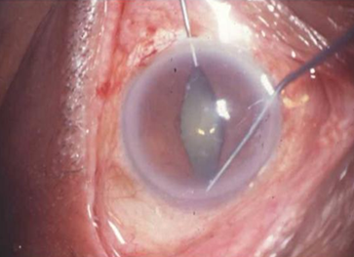
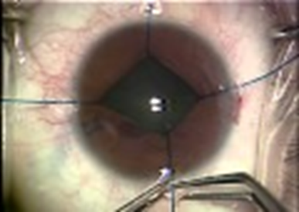
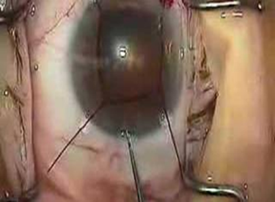
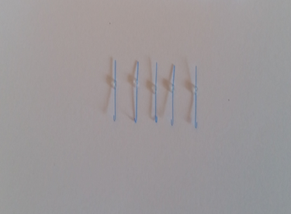
Beehler pupil dilator

Slide 29
III.4.2. Intraoperative Treatments:
Intraocular dexamethasone (400 μg) may be instilled into the AC when the wound is closed
Alternatively, triamcinolone acetate may be injected into the AC at the end of combined cataract and posterior segment surgery
At the end of the surgery, an intraoperative antibiotic such as 0.1 cc can be injected.

Slide 30
IV. CONTROLO POSTOPERATIVE INFLAMMATIO
Help control postoperative inflammation:
Injection of preservative-free triamcinolone into :
  AC, vitreous cavity ,
  Sub-conjunctival,
  Sub-Tenon’s injection of triamcinolone or other steroids
Some study:
single AC injections of triamcinolone acetonide and gentamicin
In some cases, systemic steroids are administered as an intravenous infusion during surgery and are then continued orally in the postoperative period

Slide 31
V. Complications
Intraoperative Complications
Iris Prolapse
Anterior Capsule Tears
Rupture of the Posterior Capsule
Prolapse of the Vitreous Body
Zonular Dialysis
Postoperative Complication
Recurrence of inflammation
Endothelial damage,
Hyphema
Fibrous membranes (mostly in pars planitis patients)
High IOP
PCO
  Cystoid macular edema (CME)
  Cyclitic membrane – phthisis
IOL deposits
Epiretinal membranes, and
Glaucomatous optic nerve damage

Slide 32
V. Postoperative Follow-up
Uncomplicated cases is to prescribe prednisolone or dexamethasone 4/daily starting immediately after surgery and then taper over the following 4–6 weeks.
Complicated cases may additionally receive systemic steroids started preoperativelyand continuing for 2 weeks
with gradual tapering over 15 days.
In the most severe cases, moderate to high doses of oral prednisolone (1–1.5 mg/kg/ day) and intensive topical
corticosteroid drops should be given and tapered soon
afterward.

Slide 33
References
1.Selection of Surgical
Technique for Complicated
Cataract in Uveitis, Mauricio
Miranda, Jorge L. Alió
2.Perioperative Medical
Management, Manfred Zierhut,
Peter Szurman
3.Pars Plana Lensectomy,
Emilio Dodds
4. Extracapsular Extraction
by Phacoemulsification
Antoine P. Brézin, Dominique Monnet
5. Selection of Intraocular Lenses:
Materials, Contraindications,
Secondary Implants, Gerd U. Auffarth
6. Management of Posterior Synechiae,
Peripheral Anterior Synechiae,
Iridocorneal Adhesions, and Iridectomy
Yosuf El-Shabrawi
7. Complications Post Cataract Surgery
in the Uveitic Eye, Marie-José
Tassignon, Dimitrios Sakellaris
8. Cataract Surgery in Childhood
Uveitis Arnd Heiligenhaus, Carsten
Heinz, Bahram Bodaghi

Slide 34
THANK FOR YOUR ATTENTION

